Slide 1
Customer Churn Prediction System
Utilizing Machine Learning and Streamlit for Proactive Retention
Student Name Darren Fortun Fotsing Tankam Reg: 23923030019
Institution KL University CDOE Guided by: Dr. Rajeev Kudari / Dr. P Srilatha

Slide 2

Reactive retention strategies waste capital and fail to prevent customer attrition.
Traditional customer relationship management (CRM) relies on intervention only after a cancellation request is submitted.
Core Limitations of Current Systems
—
Lack of real-time automated risk evaluation based on billing and contract data.
Without an automated, data-driven mechanism to evaluate real-time risk profiles, businesses cannot distinguish between secure clients and those on the verge of leaving. This results in misallocated marketing spend and high customer acquisition costs to replace lost recurring revenue.
—
Marketing capital is wasted on broad, untargeted retention campaigns.
—
The cost of acquiring new clients is significantly higher than retaining existing ones.
PROBLEM STATEMENT
CUSTOMER CHURN PREDICTION SYSTEM

Slide 3
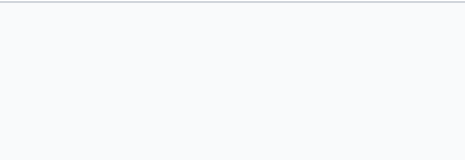

The objective is to build a proactive, real-time churn prediction pipeline.
1. Data Engineering
2. Pipeline Automation
Design and implement a synthetic dataset generation script that accurately replicates real-world telecom customer demographic and billing behavior.
Build an automated preprocessing pipeline that seamlessly handles categorical label encoding and standard numerical scaling for model ingestion.
3. Model Training
4. Web Deployment
Train and evaluate an ensemble Machine Learning model (Random Forest Classifier) to accurately classify binary churn risk.
Serialize trained model artifacts for offline inference and deploy an interactive Streamlit web application for real-time stakeholder decision support.
OBJECTIVES & SCOPE
CUSTOMER CHURN PREDICTION SYSTEM

Slide 4

Predictive CRM modeling favors ensemble machine learning for complex interactions.
Evolution of CRM Analytics
Predictive modeling in customer relationship management has evolved significantly from classical statistical regressions to advanced ensemble machine learning techniques.
Deployment Criticality
Current literature emphasizes that a model's predictive power is only as good as its deployment pipeline.
Research demonstrates that tree-based algorithms—specifically Random Forests—excel in tabular business datasets. This is due to their immunity to feature scale variations and their unique ability to capture non-linear interactions between diverse metrics like customer tenure, billing tiers, and service options.
Serializing trained preprocessing scalers alongside model weights is identified as a critical best practice to maintain strict data consistency during real-time web inference, preventing silent failures in production.
LITERATURE REVIEW
CUSTOMER CHURN PREDICTION SYSTEM

Slide 5




The system architecture integrates data generation, preprocessing, and web deployment.
A strict 4-stage operational pipeline ensures that raw inputs are processed identically during both the training phase and live production inference.
1. Raw Data
2. Preprocessing
3. Serialization
4. Web Inference
Generation of synthetic demographic, contract, and billing metrics.
➔
Label Encoding and Standard Scaling (train.py execution).
➔
Exporting model weights (model.pkl) and transformations (scaler.pkl).
➔
Streamlit UI loads assets for real-time stakeholder queries.
SYSTEM ARCHITECTURE
CUSTOMER CHURN PREDICTION SYSTEM

Slide 6
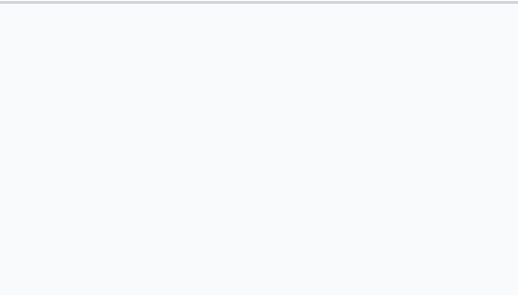
Preprocessing transforms text and scales continuous variables for model ingestion.
Machine Learning models operate strictly on numerical matrices. The preprocessing pipeline handles two mandatory structural transformations before the data reaches the prediction engine.
TRANSFORMATION 1
TRANSFORMATION 2
Categorical Label Encoding
Standard Feature Scaling
Text-based categorical variables (e.g., Gender, Contract Type, Payment Method) cannot be processed mathematically. The LabelEncoder transforms these strings into standardized integer representations (0, 1, 2). The target variable 'Churn' is mapped explicitly to binary format (Yes = 1, No = 0).
Continuous variables like Total Charges can overshadow metrics with smaller scales like Tenure. The StandardScaler normalizes continuous attributes to a mean of 0 and a standard deviation of 1, ensuring the algorithm weights all features equitably.
DATA PREPROCESSING
CUSTOMER CHURN PREDICTION SYSTEM

Slide 7



A Random Forest Classifier with 100 decision trees powers the prediction engine.
—
Ensemble Architecture: The engine utilizes a Random Forest Classifier configured with 100 parallel decision trees. This ensemble approach resists the overfitting common in single decision trees.
Implementation Assets
—
Decision Splitting (Gini Impurity): During training, each tree evaluates a random subset of features and rows to construct optimal split rules, progressively reducing data impurity to separate churners from non-churners.
train.py
Executes preprocessing and fits the algorithm to the 1,000 synthetic records.
model.pkl & scaler.pkl
—
Majority Voting: In the production environment, the input data passes through all 100 trees. The final output probability represents the aggregated majority vote of the entire forest.
Joblib serialization artifacts that freeze the trained weights and scaling parameters.
MODEL IMPLEMENTATION
CUSTOMER CHURN PREDICTION SYSTEM

Slide 8
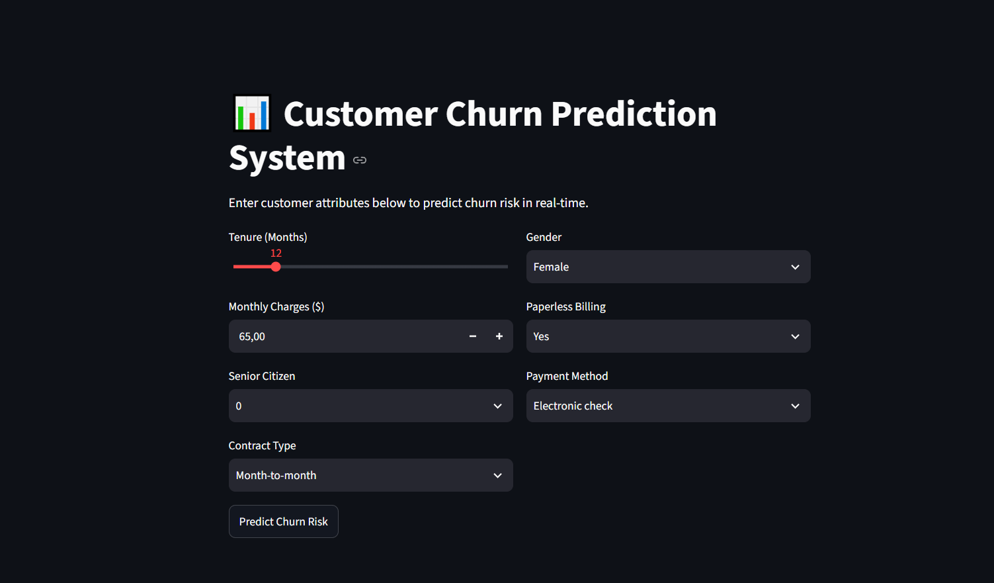
The Streamlit dashboard enables real-time probability scoring and decision support.
The app.py deployment script utilizes the Streamlit framework to translate backend machine learning logic into an accessible, interactive front-end for business stakeholders.
—
Offline Inference: Instantaneously loads the serialized model.pkl and scaler.pkl files upon launch.
—
Interactive Controls: Provides intuitive sliders and dropdowns for non-technical users to input customer metrics.
—
Low Latency Scoring: Applies the exact training transformations to live input, computing prediction probabilities in under 50 milliseconds.
WEB APPLICATION DEPLOYMENT
CUSTOMER CHURN PREDICTION SYSTEM

Slide 9
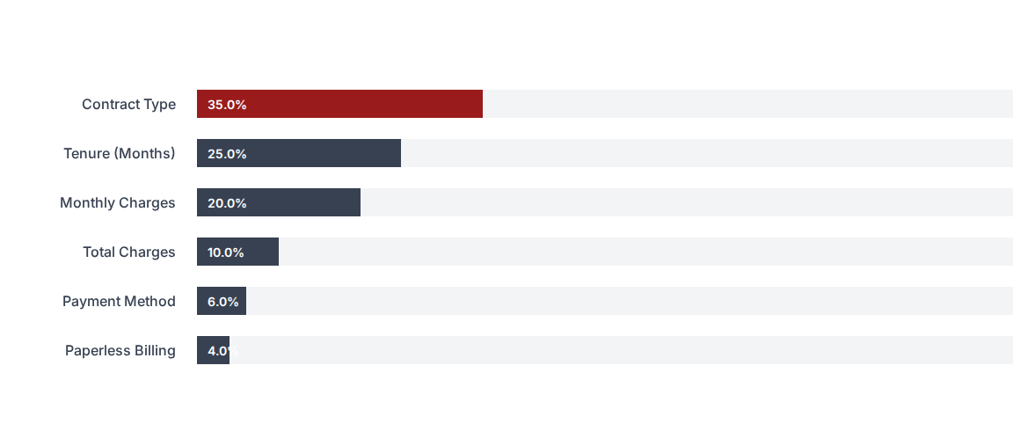
Month-to-month contracts and short tenure are the strongest indicators of churn.
Random Forest feature importance analysis reveals the weighted influence of each input variable on the final churn prediction outcome.
RESULTS: FEATURE IMPORTANCE
CUSTOMER CHURN PREDICTION SYSTEM

Slide 10



Strategic interventions should focus on contract conversion and early onboarding.
1. Incentivize Contracts
2. Early Onboarding
3. Dynamic Discounting
Finding: Month-to-month contracts have the highest churn rate due to minimal switching friction.
Finding: Customers within their first 1-12 months display the highest cancellation susceptibility.
Finding: High monthly charges accelerate churn probability significantly.
Action: Program Streamlit predictions via API into existing CRM software to automatically trigger promotional offers when risk exceeds a 65% threshold.
Action: Offer targeted financial discounts to proactively convert high-risk month-to-month accounts into one- or two-year commitments.
Action: Deploy customer success check-ins specifically targeting new subscribers within their critical first 90-day retention window.
STRATEGIC RECOMMENDATIONS
CUSTOMER CHURN PREDICTION SYSTEM

Slide 11
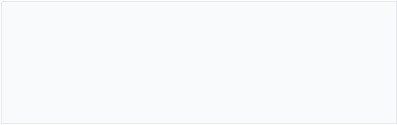
The ML pipeline successfully translates statistical operations into actionable business tools.
By integrating data preprocessing, ensemble Random Forest training, and cloud-ready web interface design, the system empowers proactive retention management.
Darren Fortun Fotsing Tankam
BCA Major Project — Register No: 23923030019
KL University CDOE

